Slide 1


Bipolar Junction Transistors
C
BJTs
B
E

Slide 2
Bipolar Junction Transistor (BJT)
Is Constructed with three doped semiconductor regions separated by two pn junctions. Base emitter junction and Base collector junction .The three regions are Emitter ,Base, and Collector
The Two Types of BJT Transistors:
npn
pnp
n
p
n
p
n
p
E
C
E
C
Cross Section
C
Cross Section
C
B
B
B
B
Schematic Symbol
Schematic Symbol
E
E
Collector doping is moderately
Base doping is slightly and very thin
Emitter doping is heavily
^{NB} please know the important of each region

Slide 3
BJT Relationships Equations
I_{E}
I_{C}
I_{E}
I_{C}
-
V_{CE}
+
+
V_{EC}
-
E
C
E
C
-
-
+
+
V_{BE}
I_{B}
V_{BC}
V_{EB}
V_{CB}
I_{B}
+
+
-
-
B
B
npn
I_{E} = I_{B} + I_{C}
V_{CE} = -V_{BC} + V_{BE}
pnp
I_{E} = I_{B} + I_{C}
V_{EC} = V_{EB} - V_{CB}
Note: The equations seen above are for the transistor, not the circuit.

Slide 4
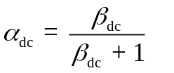
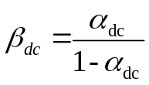
DC  and DC α
ꞵ = Common-emitter current gain
α = Common-base current gain
ꞵ = I_{C} α = I_{C}
I_{B} I_{E}
The relationships between the two parameters are:
Note: α and  are sometimes referred to as α_{dc} and ꞵ _{dc} because the relationships being dealt with in the BJT are DC.

Slide 5
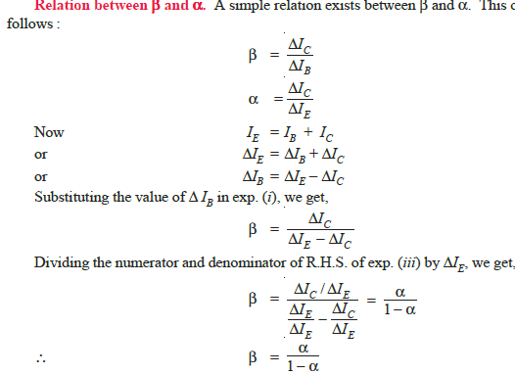

Slide 6
BJT Example
Using Common-Base NPN Circuit Configuration
C
Given: I_{B} = 50 μ A , I_{C} = 1 mA
Find: I_{E} , ꞵ , and α
Solution:
I_{E} = I_{B} + I_{C} = 0.05 mA + 1 mA = 1.05 mA
ꞵ = I_{C} / I_{B} = 1 mA / 0.05 mA = 20
α = I_{C} / I_{E} = 1 mA / 1.05 mA = 0.95238
α could also be calculated using the value of ꞵ with the formula from the previous slide.
α = ꞵ = 20 = 0.95238
ꞵ + 1 21
V_{CB}
I_{C}
+
_
I_{B}
B
V_{BE}
+
_
I_{E}
E

Slide 7
BJT Transconductance Curve
Typical NPN Transistor
Transconductance:
(slope of the curve)
g_{m} = I_{C} / V_{BE}
I_{ES} = The reverse saturation current
of the B-E Junction.
I_{C}
8 mA
6 mA
4 mA
the ratio of the change in current at the output terminal to the change in the voltage at the input terminal of an active device
2 mA
V_{BE}
0.7 V

Slide 8
Modes of Operation
Active:
Most important mode of operation
Central to amplifier operation
The region where current curves are practically flat
Saturation:
Barrier potential of the junctions cancel each other out causing a virtual short short (closed switch)
Cutoff:
Current reduced to zero
Ideal transistor behaves like an (open switch)
* Note: There is also a mode of operation called inverse active, but it is rarely used.

Slide 9
Three Types of BJT Biasing
Biasing the transistor refers to applying voltage to get the transistor to achieve certain operating conditions.
Common-Base Biasing (CB) : input = V_{EB} & I_{E}
output = V_{CB} & I_{C}
Common-Emitter Biasing (CE): input = V_{BE} & I_{B}
output = V_{CE} & I_{C}
Common-Collector Biasing (CC): input = V_{BC} & I_{B}
output = V_{EC} & I_{E}

Slide 10
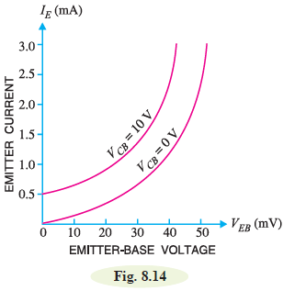
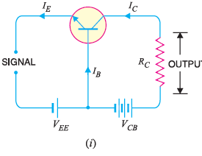
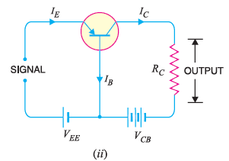
Common Base Connection (biasing)
In this circuit arrangement, input is applied between emitter and base and output is taken from collector
and base. Here, base of the transistor is common to both input and output circuits and hence the
name common base connection. In Fig. 8.9 (i), a common base npn transistor circuit is shown whereas
Fig. 8.9 (ii) shows the common base pnp transistor circuit.

Slide 11
Common-Base Output Characteristic
Although the Common-Base configuration is not the most common biasing type, it is often helpful in the understanding of how the BJT works.
Emitter-Current Curves
I_{C}
Active Region
I_{E}
Saturation Region
Cutoff
I_{E} = 0
V_{CB}

Slide 12
Common-Base
V_{CE}
I_{C}
I_{E}
Circuit Diagram: NPN Transistor
C
E
V_{CB}
V_{BE}
The Table Below lists assumptions that can be made for the attributes of the common-base biased circuit in the different regions of operation. Given for a Silicon NPN transistor.
I_{B}
+
_
+
_
B
V_{CB}
V_{BE}
Region of Operation | I_{C} | V_{CE} | V_{BE} | V_{CB} | C-B Bias | E-B Bias
Active | I_{B} | =V_{BE}+V_{CE} | ~0.7V | ❍ 0V | Rev. | Fwd.
Saturation | Max | ~0V | ~0.7V | -0.7V<V_{CE}<0 | Fwd. | Fwd.
Cutoff | ~0 | =V_{BE}+V_{CE} |  0V | ❍ 0V | Rev. | None/Rev.

Slide 13
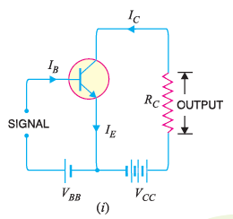
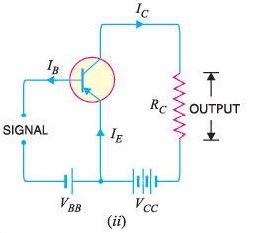
Common Emitter Connection
In this circuit arrangement, input is applied between base and emitter and output is taken from the
collector and emitter. Here, emitter of the transistor is common to both input and output circuits and
hence the name common emitter connection. Fig. 8.16 (i) shows common emitter npn transistor
circuit whereas Fig. 8.16 (ii) shows common emitter pnp transistor circuit.
IE has to be kept constant because any change in IE will produce corresponding change in IC. Here, we are
interested to see how VCB influences IC.

Slide 14
Common-Emitter output Characteristic
Circuit Diagram
V_{CE}
Collector-Current Curves
I_{C}
I_{C}
V_{CC}
+
_
I_{B}
Active Region
I_{B}
Region of Operation | Description
Active | Small base current controls a large collector current
Saturation | V_{CE(sat)} ~ 0.2V, V_{CE} increases with I_{C}
Cutoff | Achieved by reducing I_{B} to 0, Ideally, I_{C} will also equal 0.
V_{CE}
Saturation Region
Cutoff Region
I_{B} = 0

Slide 15
Common-Collector
Emitter-Current Curves
The Common-Collector biasing circuit is basically equivalent to the common-emitter biased circuit except instead of looking at I_{C} as a function of V_{CE} and I_{B} we are looking at I_{E}.
Also, since α ~ 1, and α = I_{C}/I_{E} that means I_{C}~I_{E}
I_{E}
Active Region
I_{B}
V_{CE}
Saturation Region
Cutoff Region
I_{B} = 0

Slide 16
Here we list the applications of transistors. (practical applications of transistors ) :
1. Transistors are used in digital and analog circuits as a switch.
2. uses in signal amplifier devices
3. Cellular phones would be one of the most widely used applications of transistors. Every cell phone uses a transistor amplifier.
4. uses in power regulator and controllers
5. in modern electronics IC uses in almost every electronics applications. Transistors are used in building some of the integrated circuits ( IC ).
6. The microprocessor includes more than billion of transistors in each chip.
7. Transistors are used in almost every electronics devices from stoves to computers and pacemakers to aircraft.
8. in calculators, computers, radios and also hearing phones every daily life device which requires good sound quality ( because transistor are often used in amplifying circuits )
9. The military used the transistor’s high-power radio frequency (RF) abilities in radar and hand-held two-way radios.
10. Darlington transistor pairs are often used in touch- and light-sensing devices.
11. Radiation – hardened transistor is often used in satellite and other aerospace applications.
After knowing some brief everyday uses of transistors, We take look into some important transistor applications in details :
1.Transistor as a switch
2. Transistor as an amplifier

Slide 17
THE BJT AS A SWITCH
BJT can be used as a linear amplifier. The second major application area is switching applications. When used as an electronic switch, a BJT is normally operated alternately in cutoff and saturation. Many digital circuits use the BJT as a switch.
Cutoff =open switch =high resistance =off
Saturation =closed switch =low resistance = on

Slide 18
Switching Operation
The basic operation of a BJT as a switching device.
(a) the transistor is in the cutoff region because the base-emitter junction and base-collector are reverse biased. In this condition, there is, ideally, an open between collector and emitter, as indicated by the switch equivalent.
(b), the transistor is in the saturation region because the base emitter junction and the base-collector junction are forward-biased and the base current is made large enough to cause the collector current to reach its saturation value. In this condition, there is, ideally, a short between collector and emitter, as indicated by the switch equivalent. Actually, a small voltage drop across the transistor of up to a few tenths of a volt normally occurs, which is the saturation voltage, VCE(sat).

Slide 19
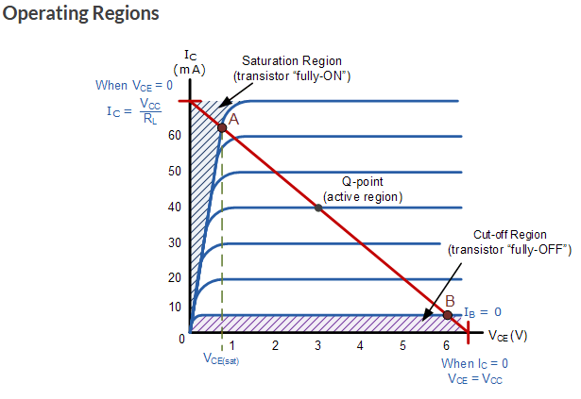

Slide 20

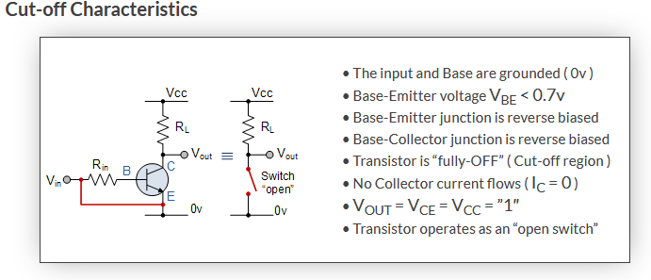

Slide 21
